Slide 1
End of the Year Literacy Markers for Students
Anderson Elementary
Novella Yim, Samantha Wong, Kristi Luk, Anita Chang, Kitty Tung, Jessica C, Michelle Li, Tim Craddock, Rav Grewal, Jas Gill

Slide 2
Grade | Reading | Writing
K | Understands the directionality of print Differentiates between letters and words Identifies most letters of the alphabet and the sounds they make Matches most uppercase and lowercase letters Identifies a few common high frequency words Identifies basic punctuation (period, question mark, exclamation point) Demonstrates reading-like behaviours with familiar pattern books o Tells the story based on the pictures Recognizes repeated words Remembers the pattern of the text Tells a story based on the picture retells some events from a story (beg, middle, end) identifies a piece of information from a non-fiction text expresses like or dislike for a text and gives a simple reason uses pictures, context clues, and prior knowledge to make a simple prediction makes a personal connection to the text when asked a direct prompting question ask a simple question about the text | Knows where to start writing and the appropriate direction Differentiates between letters and words Identifies most letters of the alphabet and the sounds they make Matches most uppercase and lowercase letters Uses a combination of uppercase and lowercase letters when printing (ex, GeOrGe) Labels pictures with letters and/or words Uses knowledge of letter sounds to represent some sounds in a word they want to write (e.g., first sound, last sound) Attempts to use simple punctuation when role playing writing

Slide 3
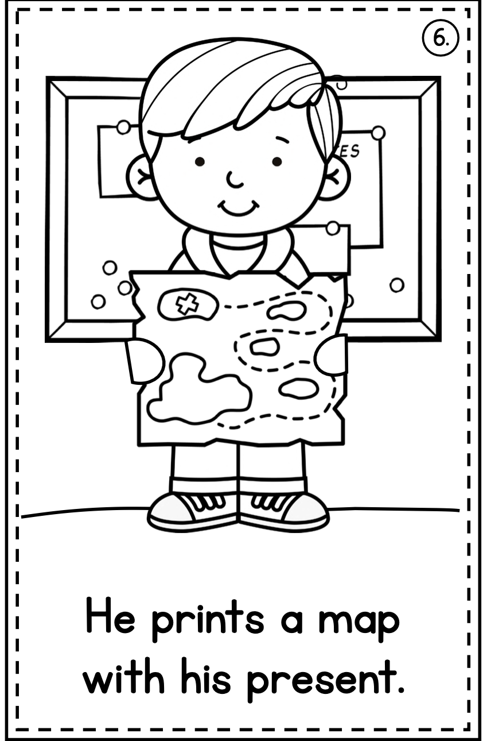
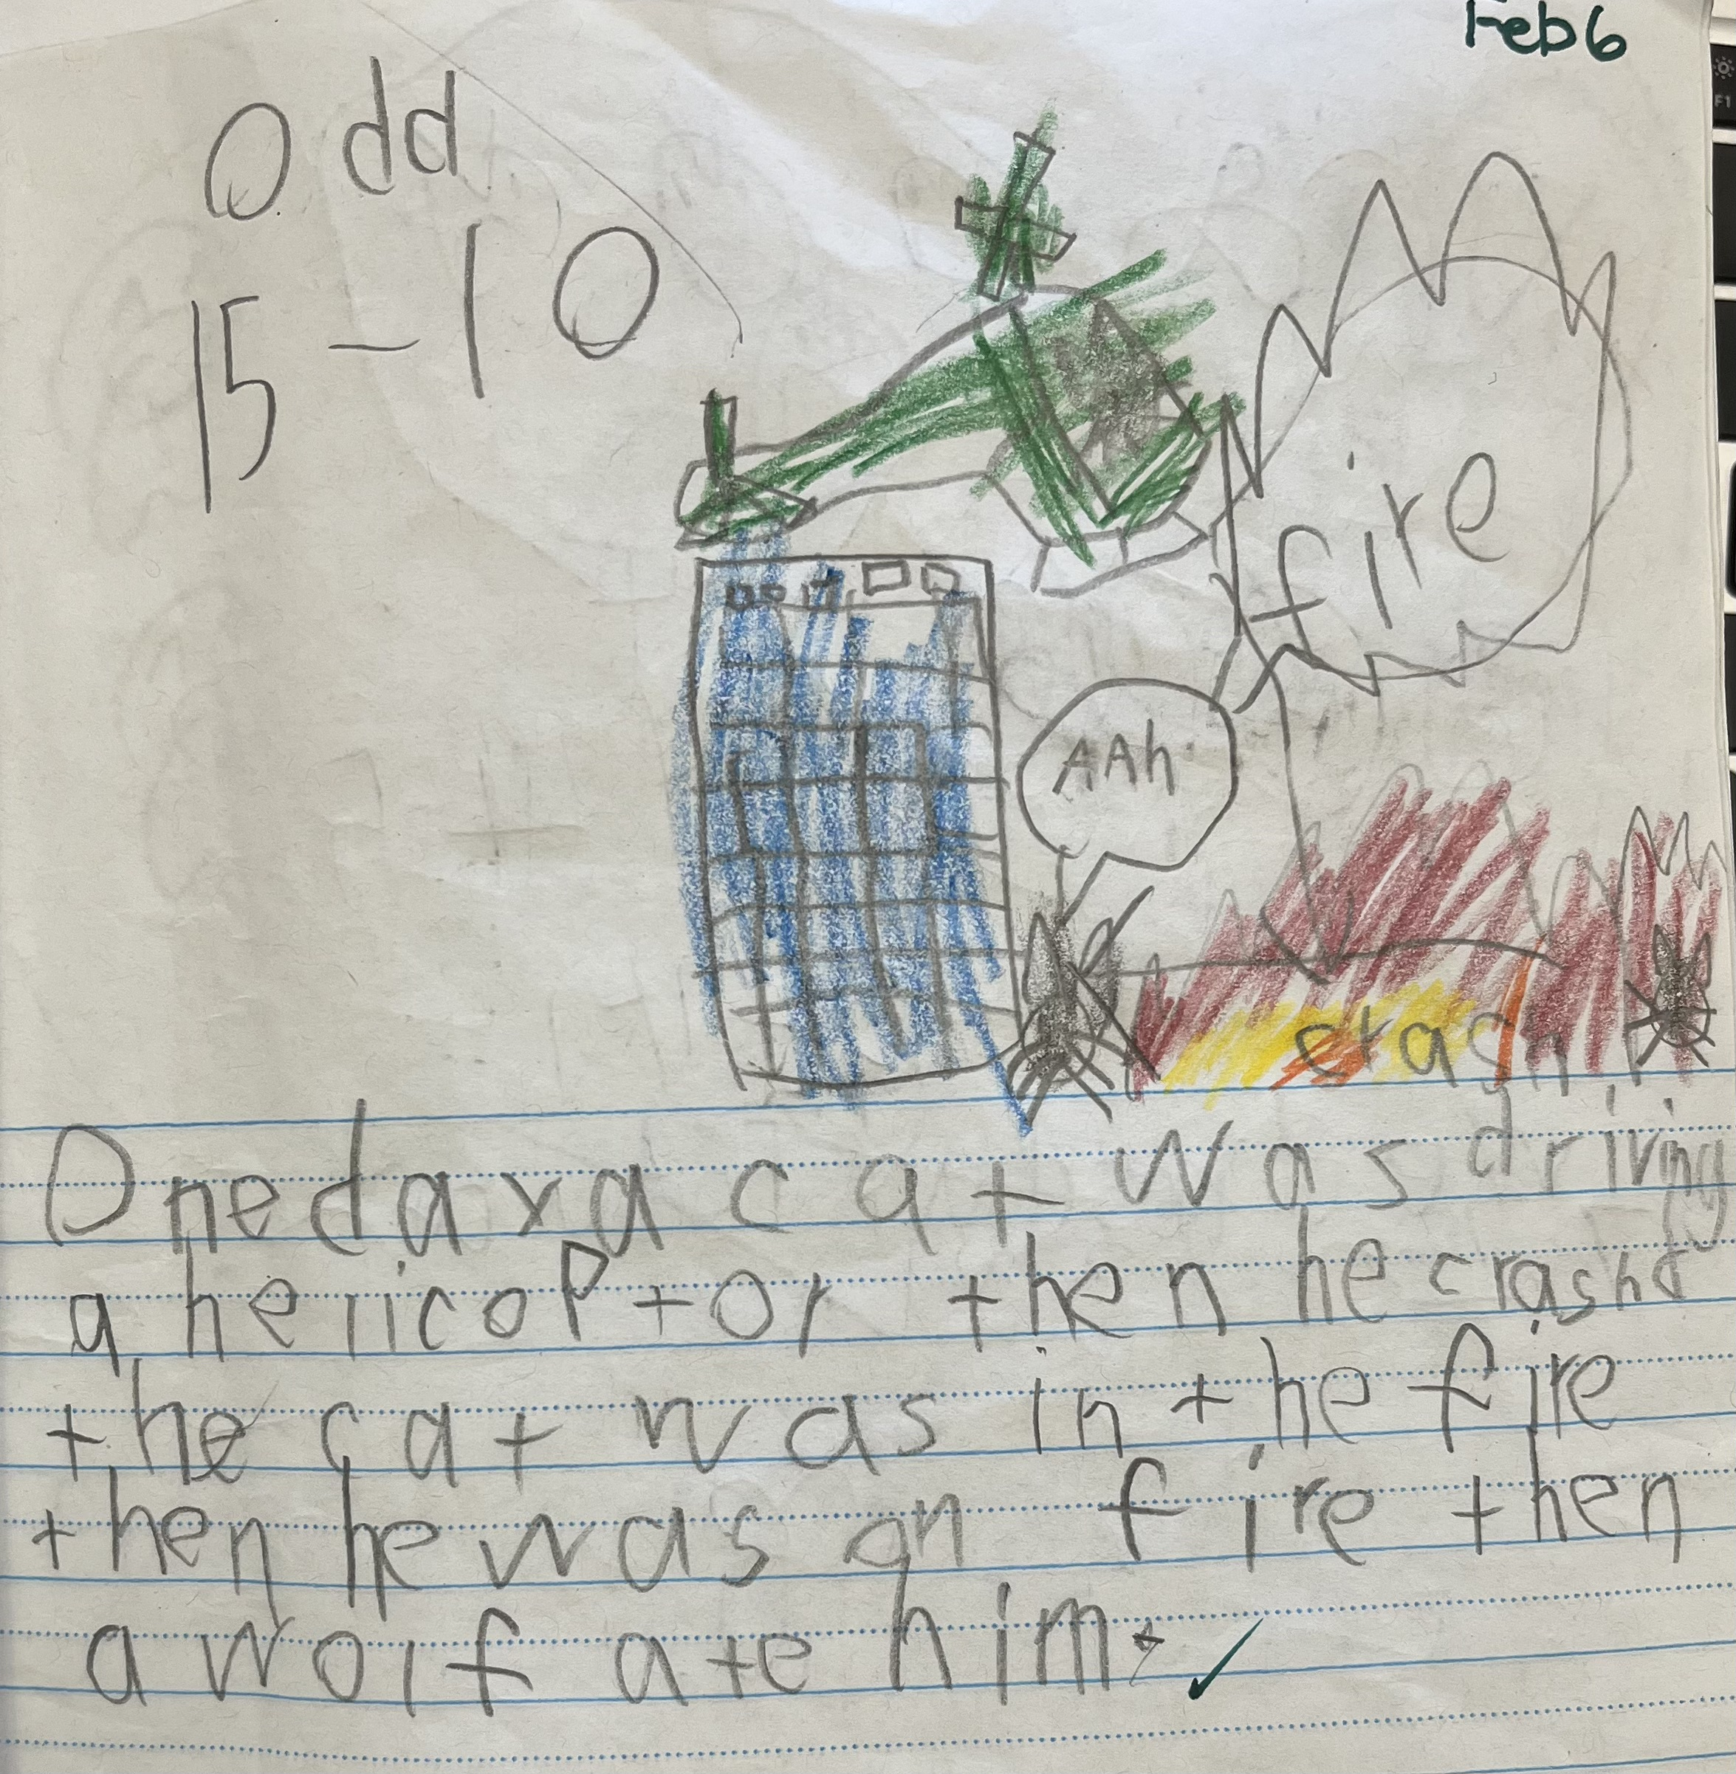
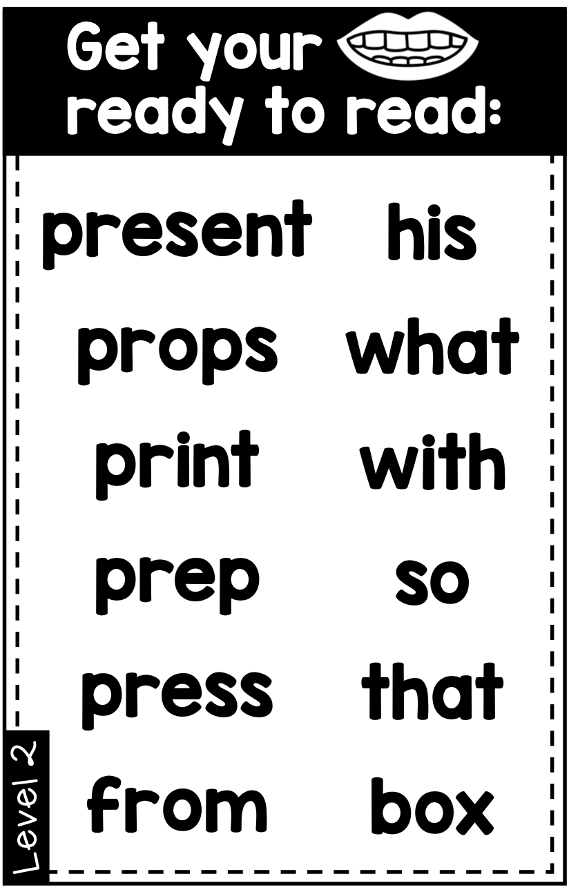
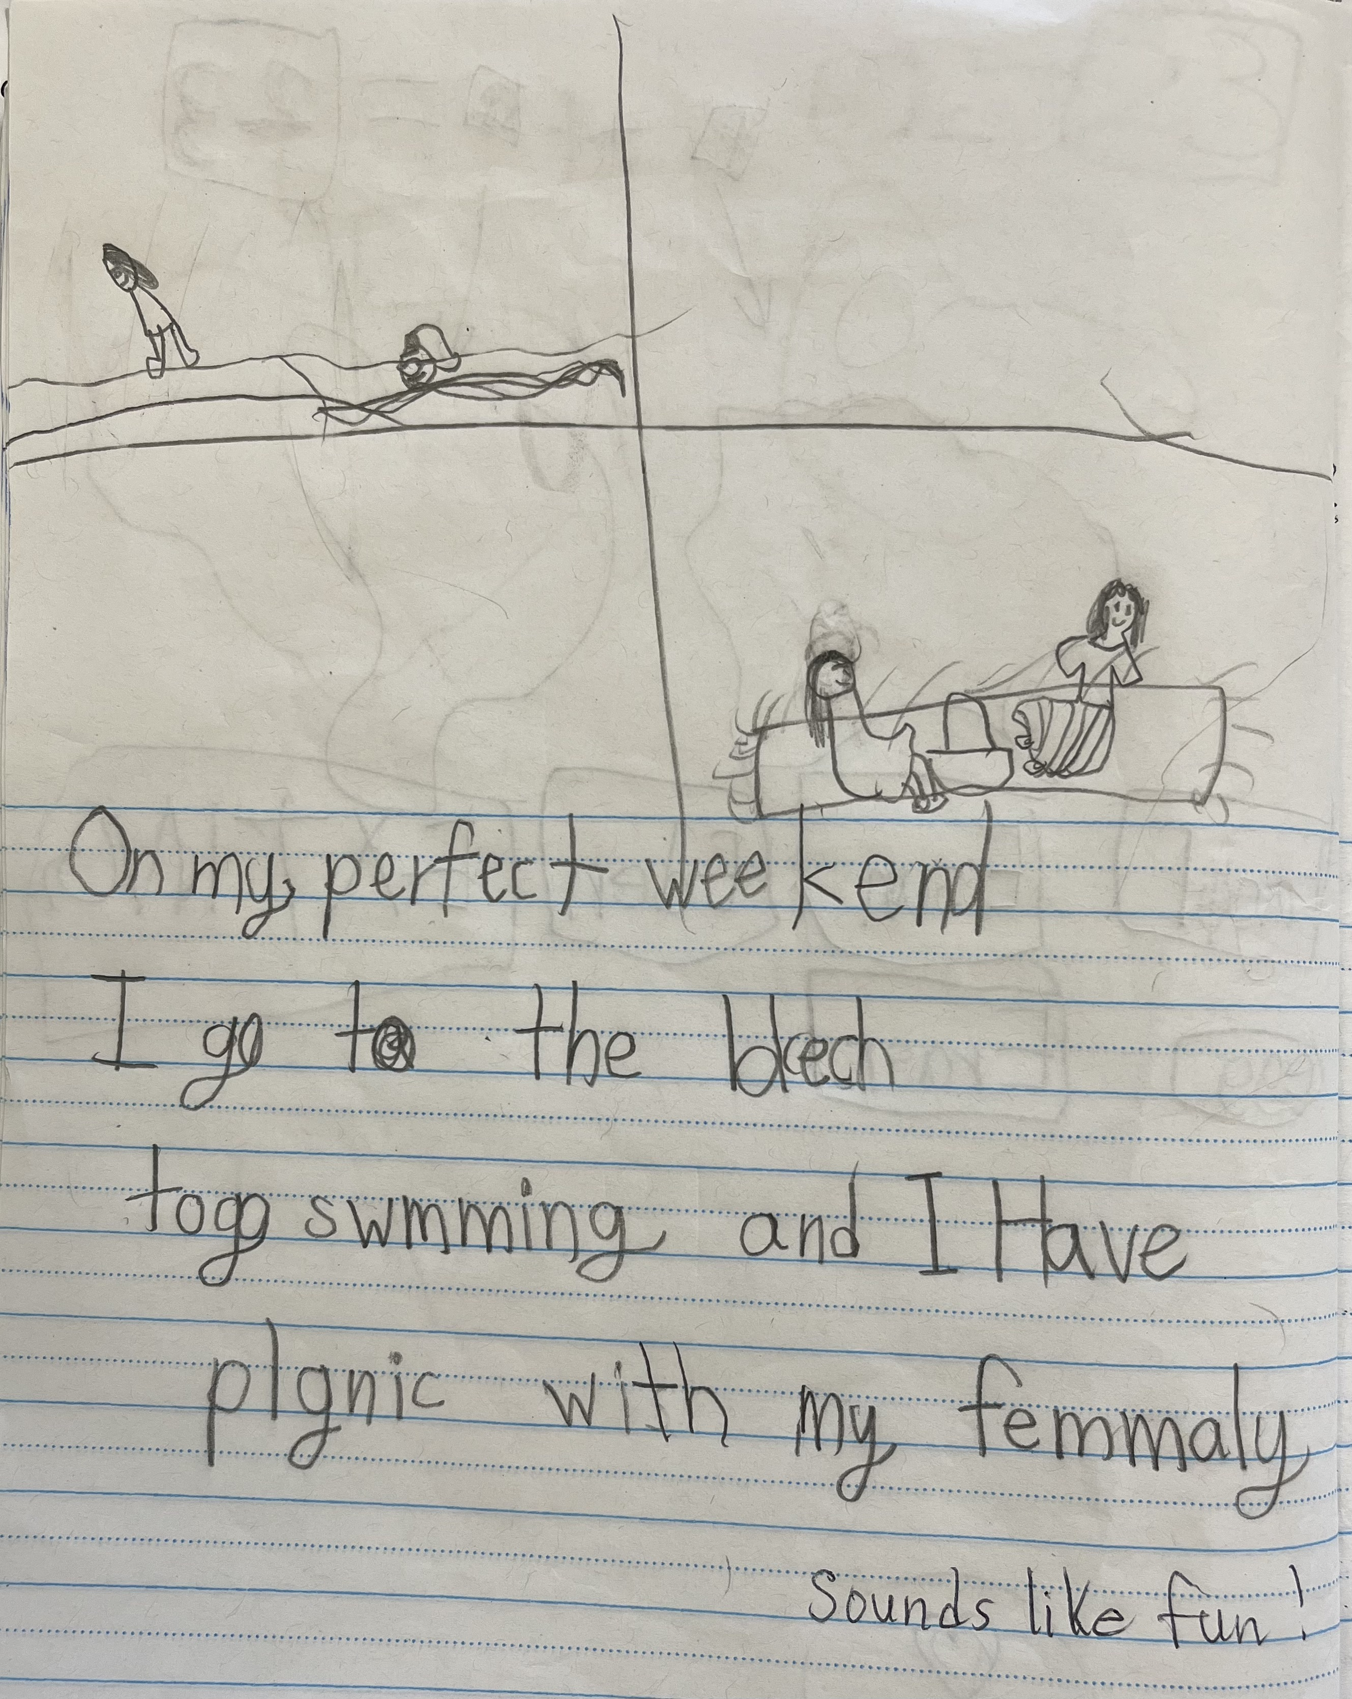
Grade | Reading | Writing
1 | Decoding with the pictures: "He is holding a map." Identifying blends, digraphs, and sight words Fry word List Grade 1 https://www.k12reader.com/worksheet/first-grade-master-spelling-list/view/ | Beginning, middle and end. Beginning details. Recognizing sight words to use in writing.

Slide 4
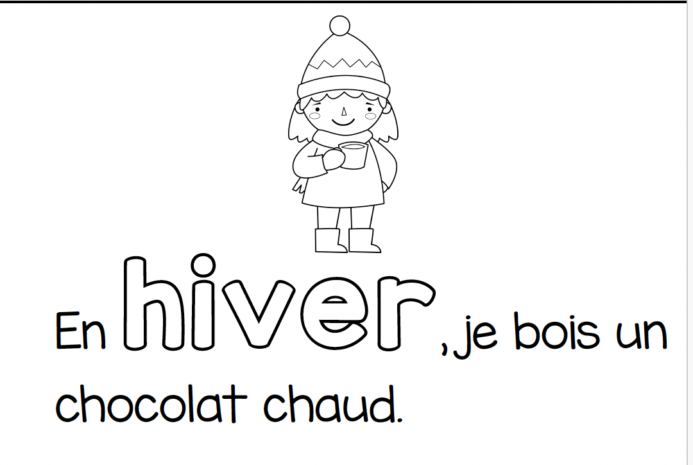
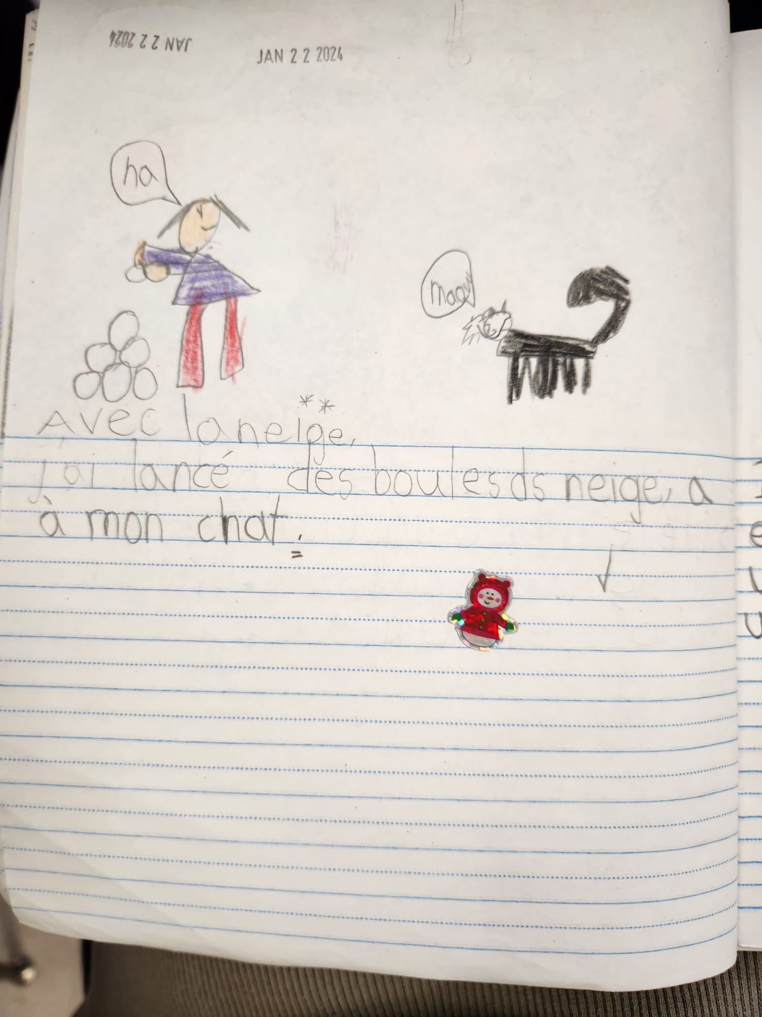
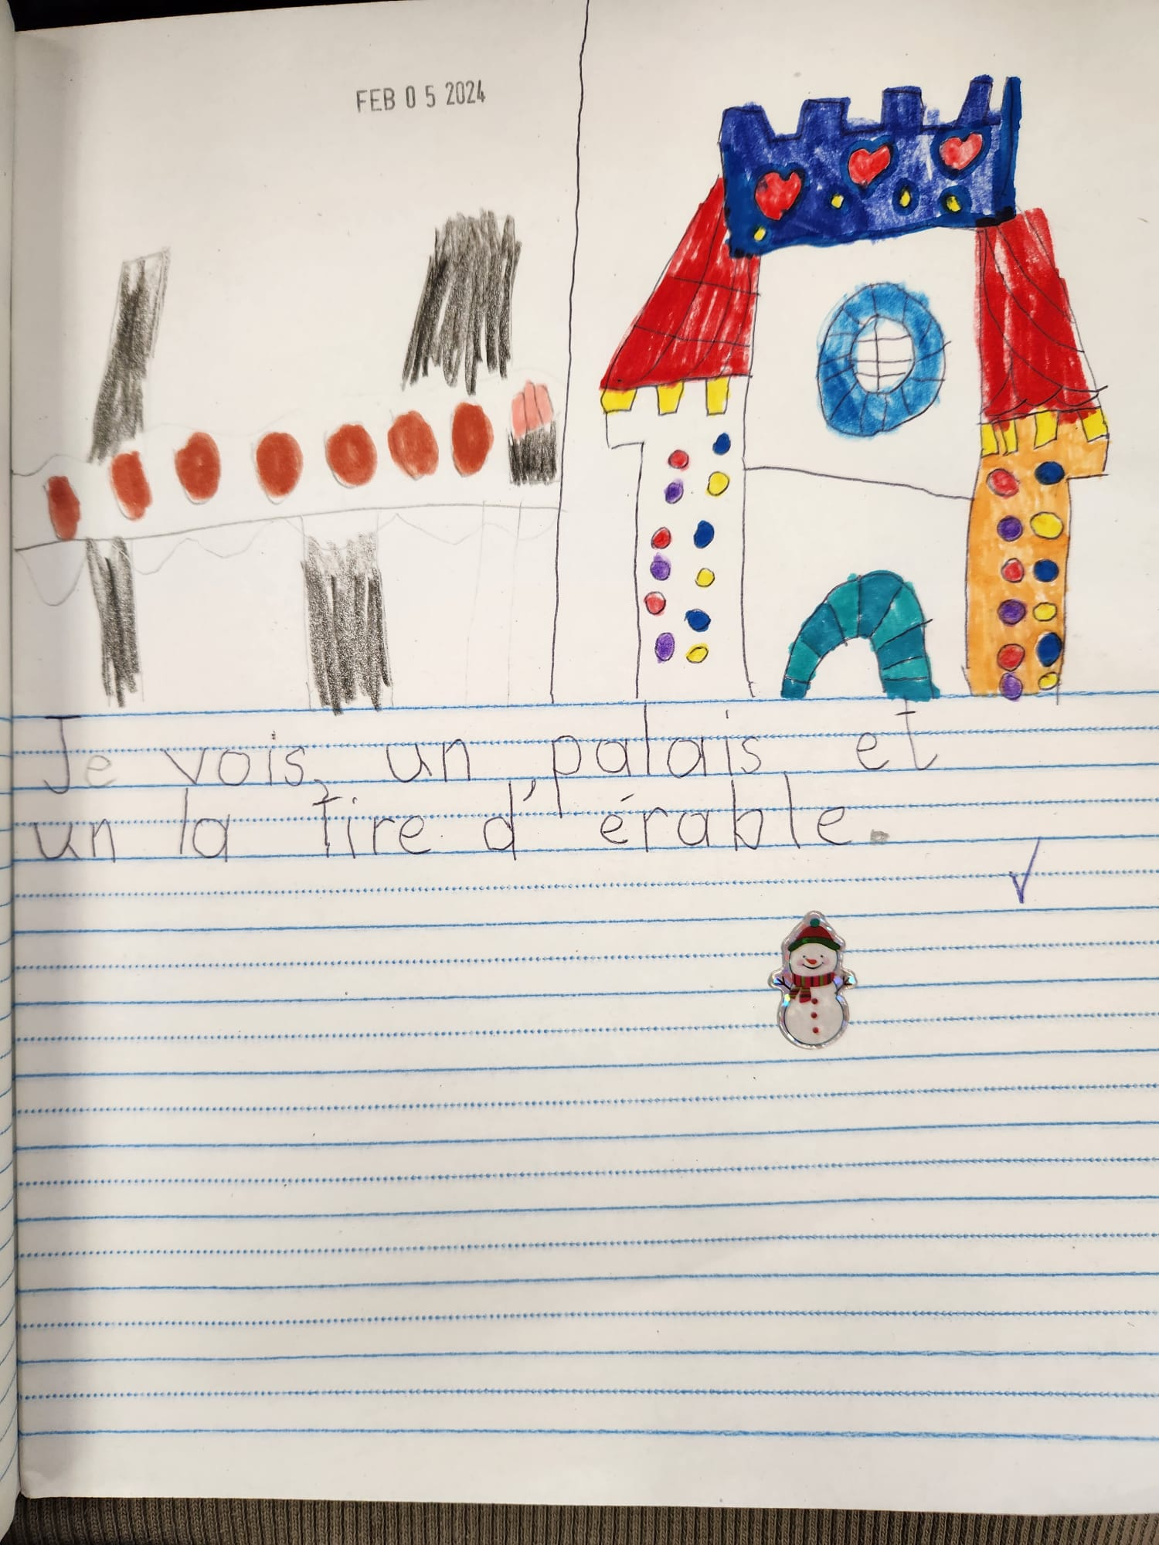
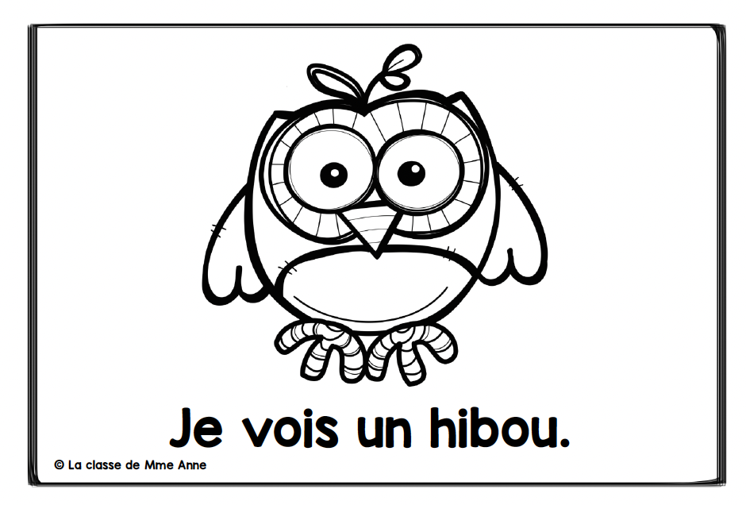
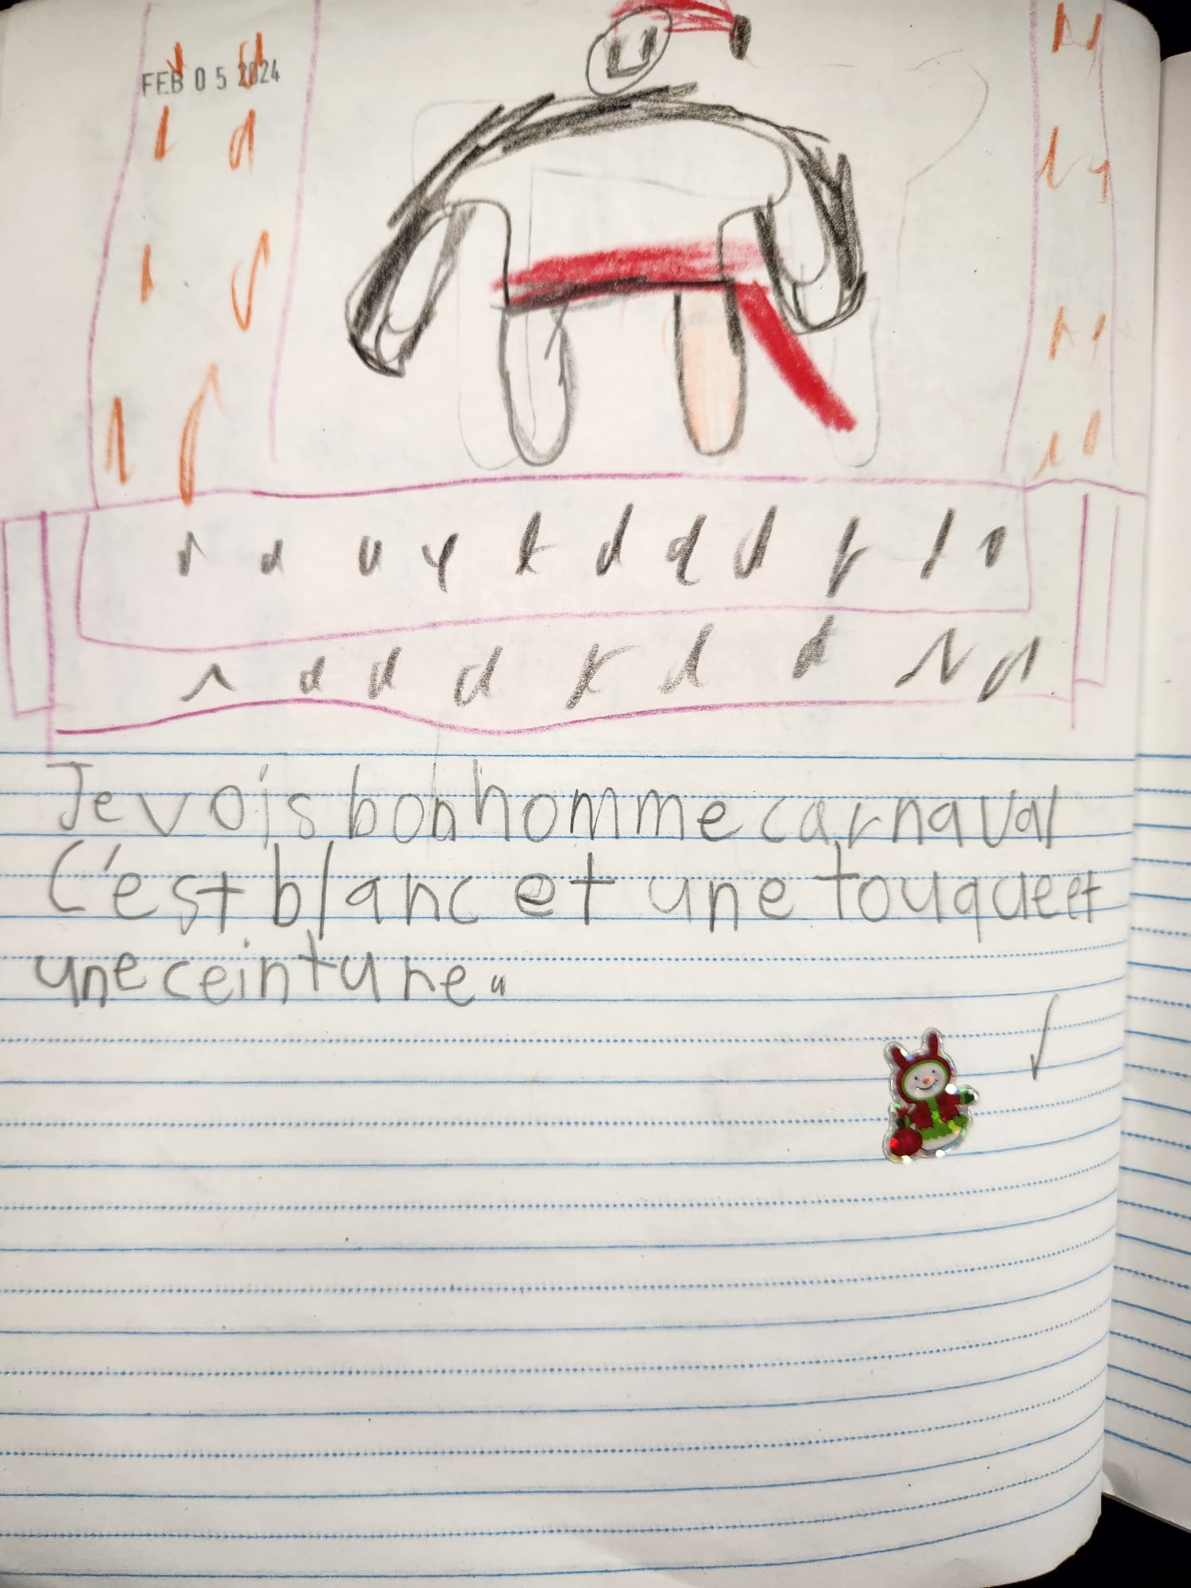
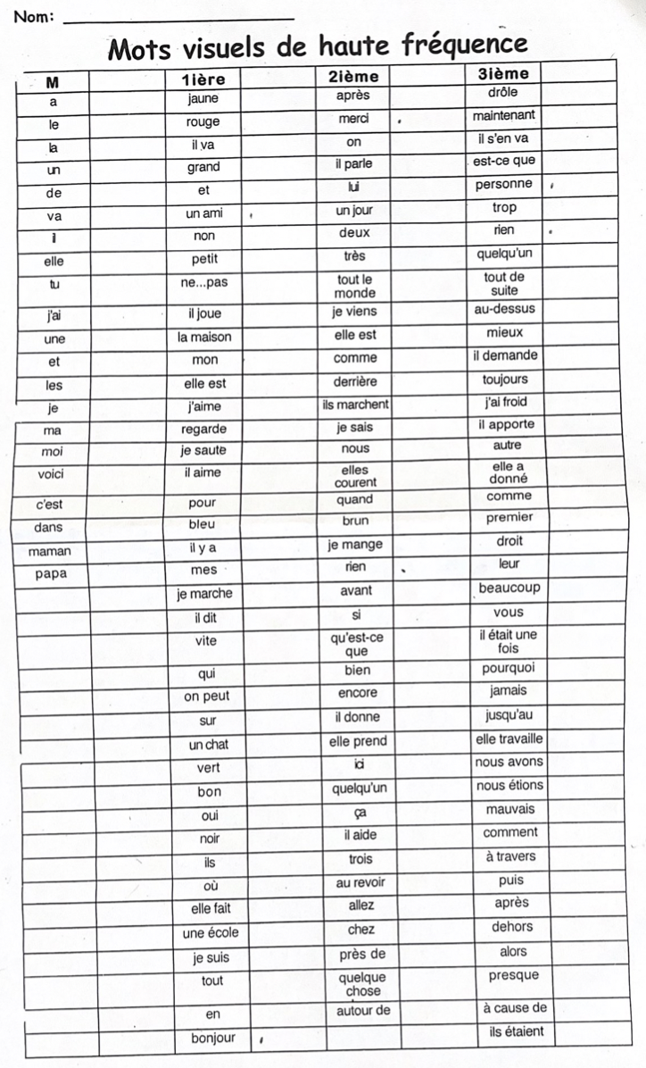
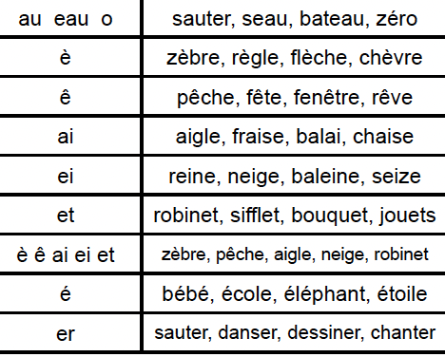
Grade | Reading | Writing
1 (French) | Decoding with the pictures: "Je vois ____ " Identifying sight words (Les mots fréquents) and sounds | Beginning, middle and end Beginning details. Recognizing sight words to use in writing. spelling words based on phonemic awareness

Slide 5
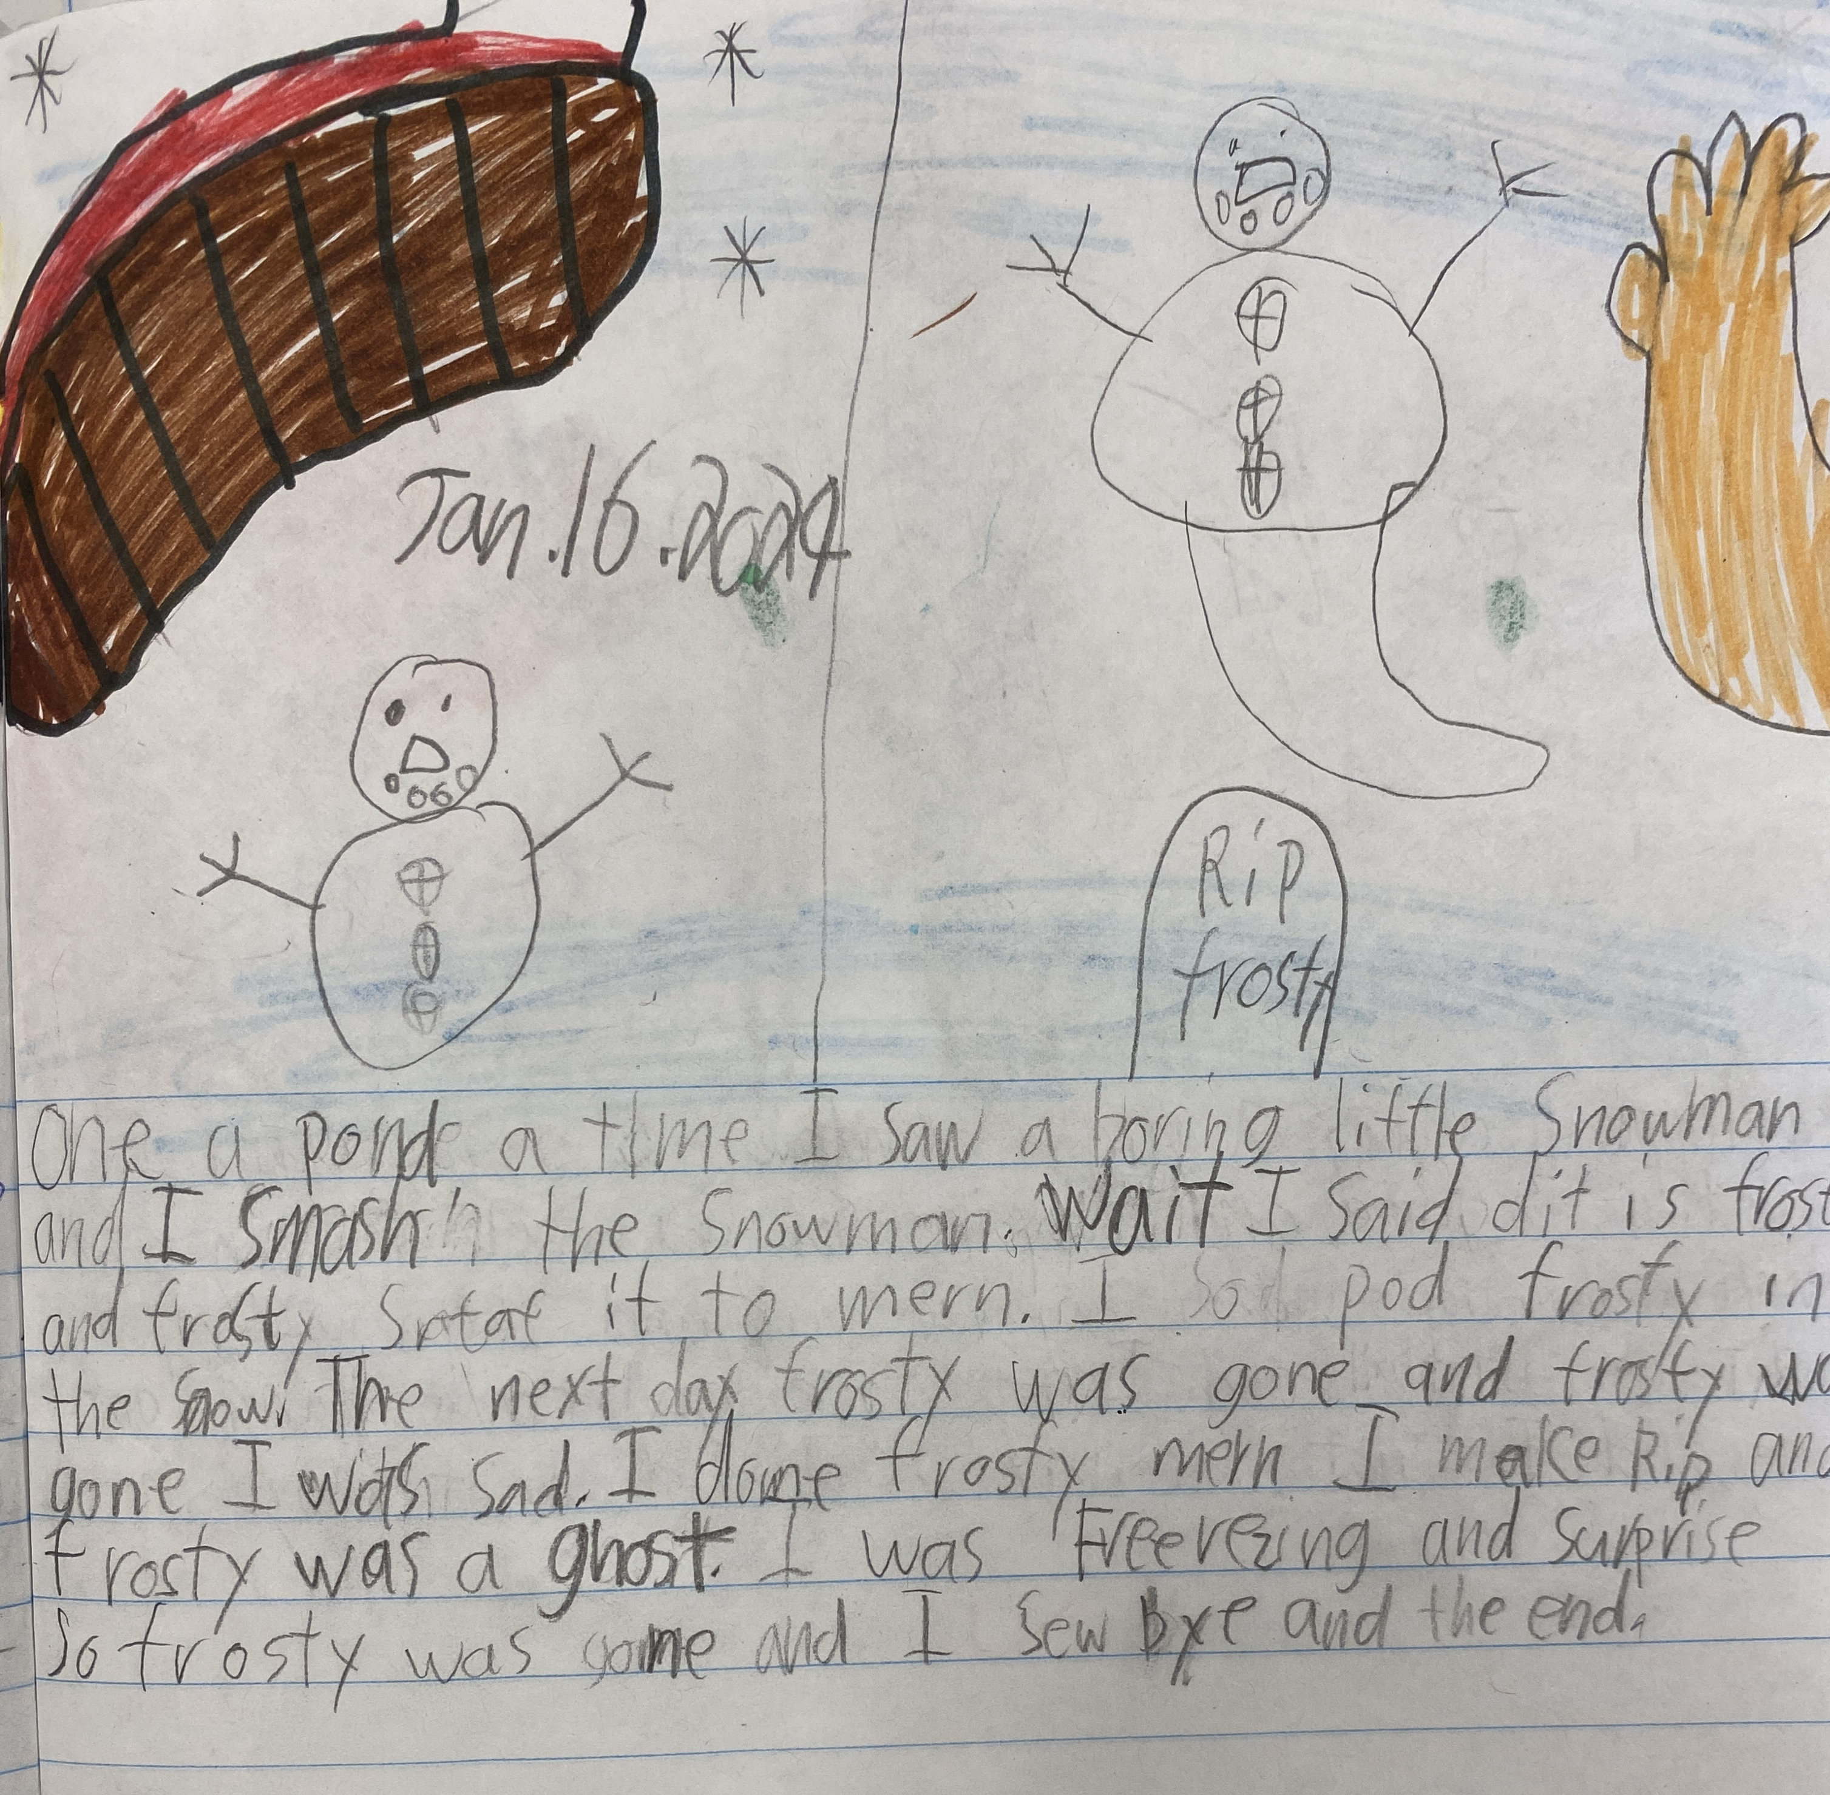
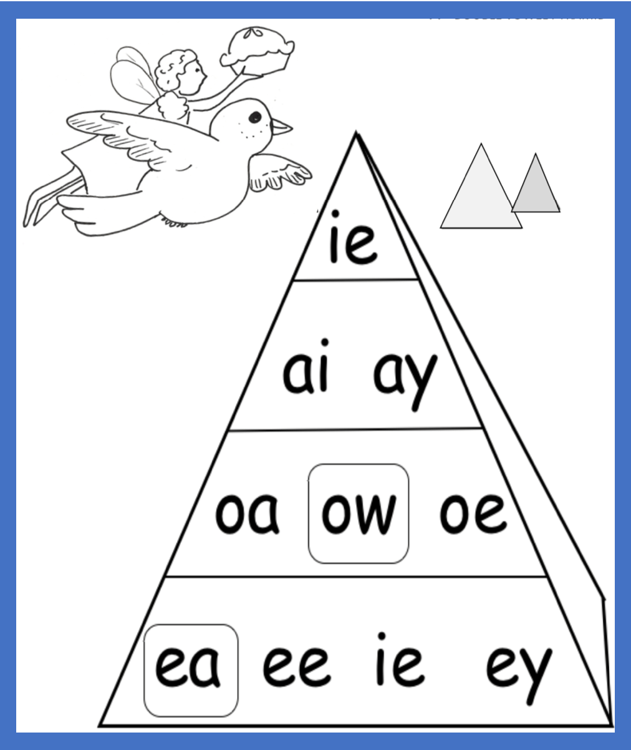
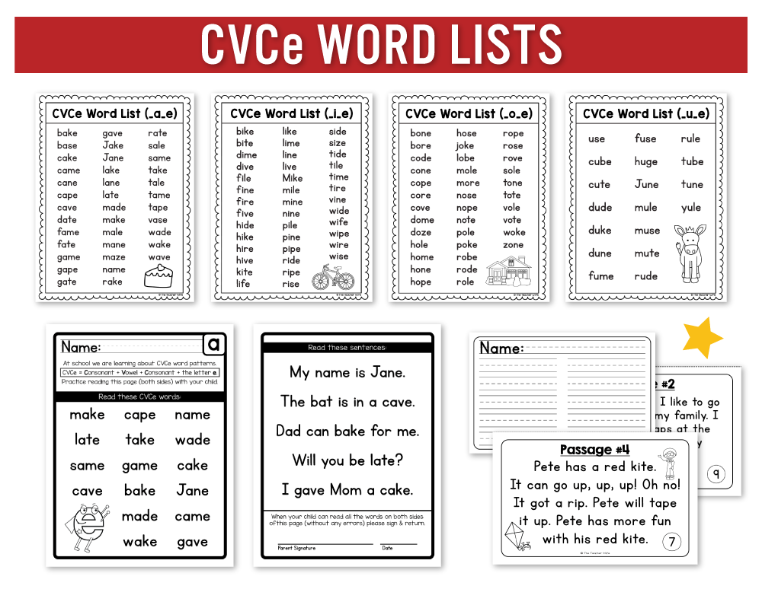
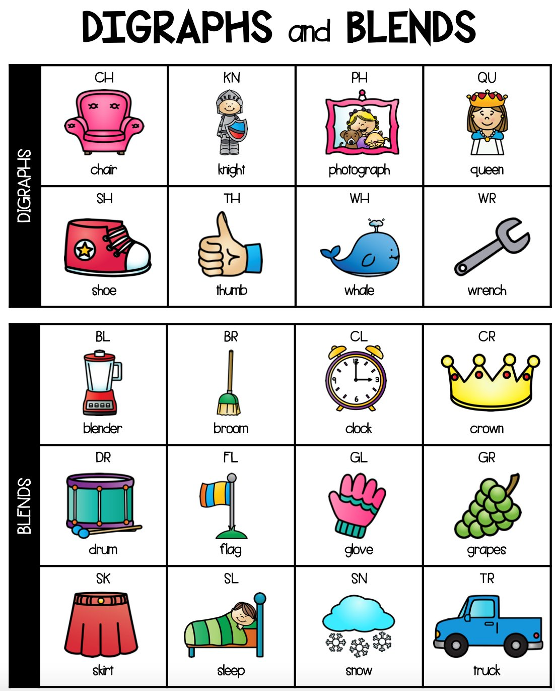
Grade | Reading | Writing
2 | Decoding Decoding words with greater accuracy & automaticity Accurately decode multisyllabic words that sound like they are spelled (e.g., understand) Recognize more high-frequency words https://manage38.rockyview.ab.ca/nosecreek/our-school/programs/sight-words/grade-2-sight-words/ Decoding – begins to read & spell words with: Long vowels Distinguish between long and short vowels CVCe (vowel-consonant-e words – e.g., live, gave) Digraphs & blends R controlled vowels Diphthongs | Writes complete sentences and compound sentences Uses uppercase letters to start names and sentences most of the time; mostly uses lowercase letters for everything else Uses knowledge of letter sounds and phonics to write words and includes most sounds; begins to include spelling patterns such as silent ‘e’, long vowel teams, etc

Slide 6
Grade | Reading | Writing
2 | Fluency Can read and make meaning of short phrases (no longer word-by-word) Begin to use some expression while reading Reading with a good rate & flow Comprehension Identifying the main idea of the story in the correct sequence (in logical order) Demonstrate understanding of the characters, setting, and plot in a story

Slide 7
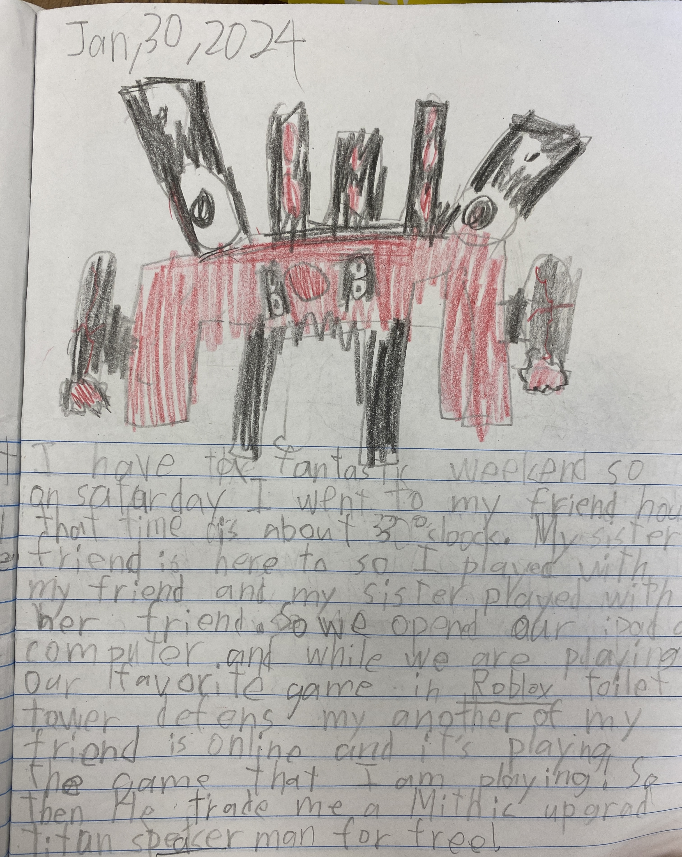
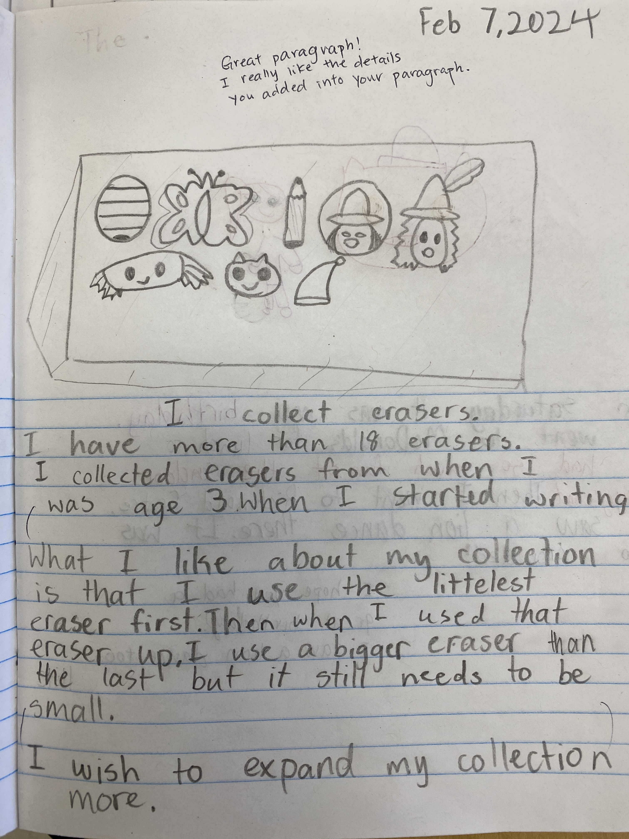
Grade | Reading | Writing
3 | Decoding words with greater accuracy and automaticity and fluency. Starting to build automaticity in comprehension Word work: long vowel teams (ee, ea, ai, ay, oa, ou, oe, ie, ue, oo, silent e Silent letters: k (knee), b (numb), h (when), t (castle, watch) Spelling word list: https://www.k12reader.com/spelling/3rd-grade-spelling-master-list-r.pdf | Can sequence sentences in a logical manner. Uses simple punctuation (period, question mark, exclamation mark, apostrophe for contractions) Provides information on the topic and includes some details

Slide 8
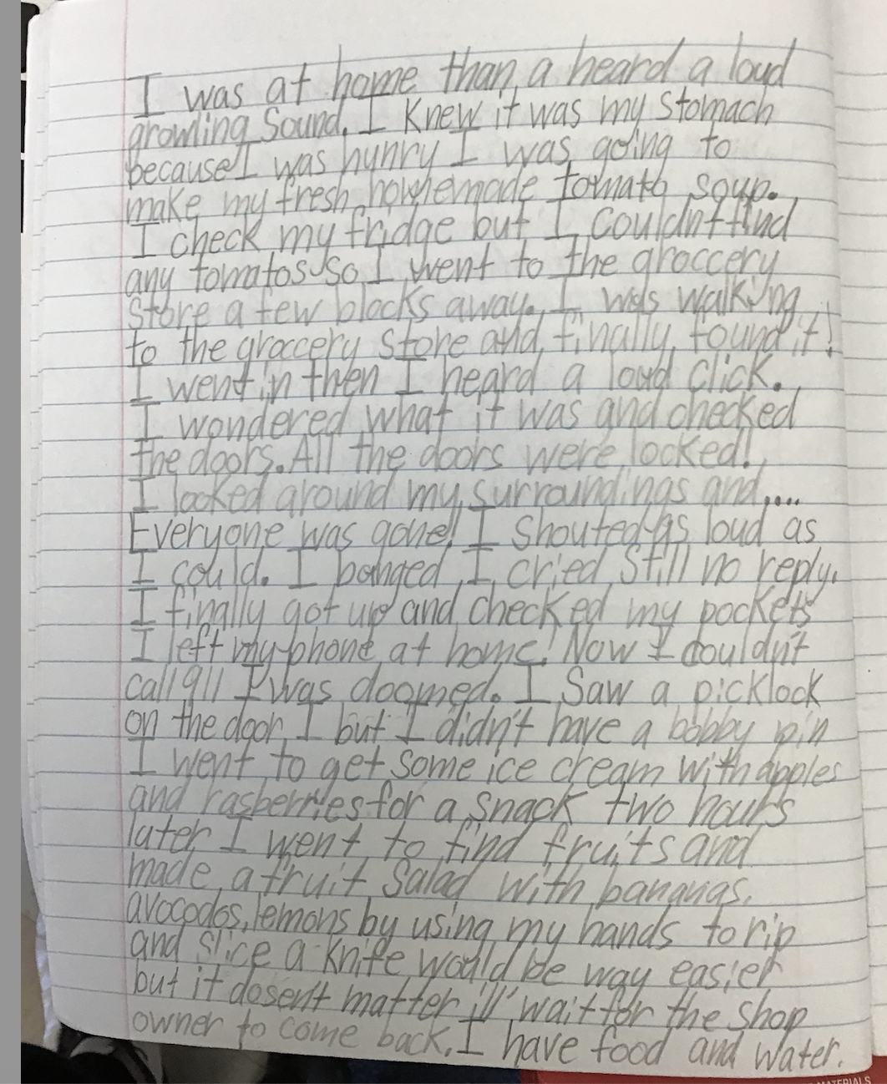
Grade | Reading | Writing
4 | Decoding words with greater accuracy and automaticity and fluency. Starting to build automaticity in comprehension Word work: complex spelling patterns (ould, dge, aught, eam, eigh, ield) Common prefixes, suffixes, and root words Greater comprehension and usage of more complex vocabulary Segmenting and blending words with multiple phonemes and complex sounds - ex: scream —->/s/-/c/-/r/-/ea/-/m/ Syllabication - ex: fan-tas-tic Homophones - see/sea, knew/new, ate/eight, real/reel Long Vowel teams- when two or more vowels work together to make one sound Diphthongs and other vowel teams - When vowels and letters come together to form one sound Common prefixes, suffixes and root words- ex: rewrite (re- prefix, write - root word), writer (write - root word, er- suffix) • prefixes - re, un, pre, mis, non suffixes - ing, ly, ful, less, er, est, ness Grade 4 Word list: https://www.k12reader.com/worksheet/fourth-grade-master-spelling-list/view/ | Uses an opening and concluding sentence. Can sequence sentences in a logical manner. Includes detail in sentences in their own words.

Slide 9
Grade | Reading | Writing
5 | Word work: Grade 5 Word list: https://www.k12reader.com/worksheet/fifth-grade-spelling-words-master-list/view/

